Slide 1

DriverPass System Analysis
Samuel Rincon
Notes:
[No speaker notes required for this slide.]

Slide 2

System Requirements
Functional Requirements:
The system allows customers to schedule driving lessons online.
Admins can manage user accounts, including resetting passwords.
Nonfunctional Requirements:
The system must be secure, ensuring data encryption during all transactions.
The system should be user-friendly and accessible on both desktop and mobile devices.
Notes:
[In your speaker notes, include an explanation of the different requirements you determined for DriverPass’s system. What are the functional requirements you selected to describe? What are the nonfunctional requirements you selected to describe? Be sure to explain how these requirements meet DriverPass’s needs.]

Slide 3
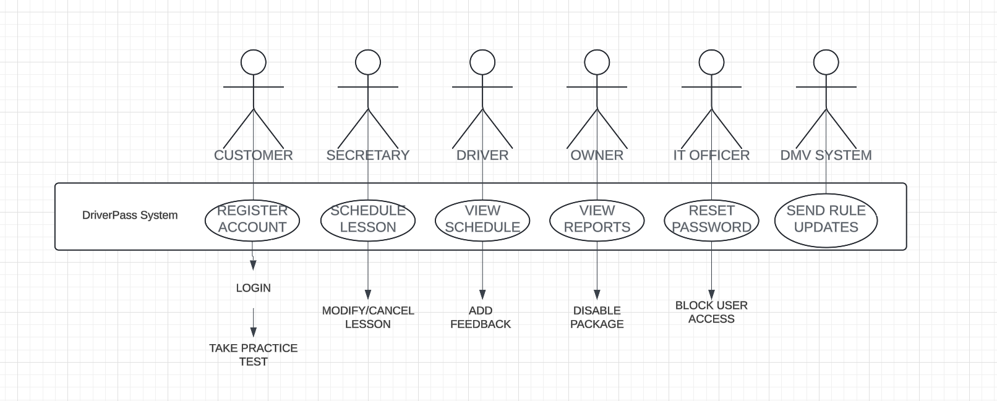
Use Case Diagram
Explanation:
The diagram represents the different users who interact with the DriverPass system. These users include:
Customers: Individuals using DriverPass to register for lessons and take practice tests.
Secretary: Manages lesson schedules, modifies, or cancels lessons based on availability.
Driver: Views the lesson schedule and provides feedback after completing a session.
Owner: Oversees system reports and can disable or manage various services/packages.
IT Officer: Handles system security, including resetting passwords and blocking user access when needed.
DMV System: Communicates updated rules and regulations to the DriverPass system to ensure the lessons comply with legal standards.
Notes:
[Explain your diagram. Who are the different actors in the system? What are the different use cases? How did you account for DriverPass’s needs in your design? In your explanation, keep your audience in mind. Avoid the use of terms like “actors” and “use cases” in your explanation.]

Slide 4
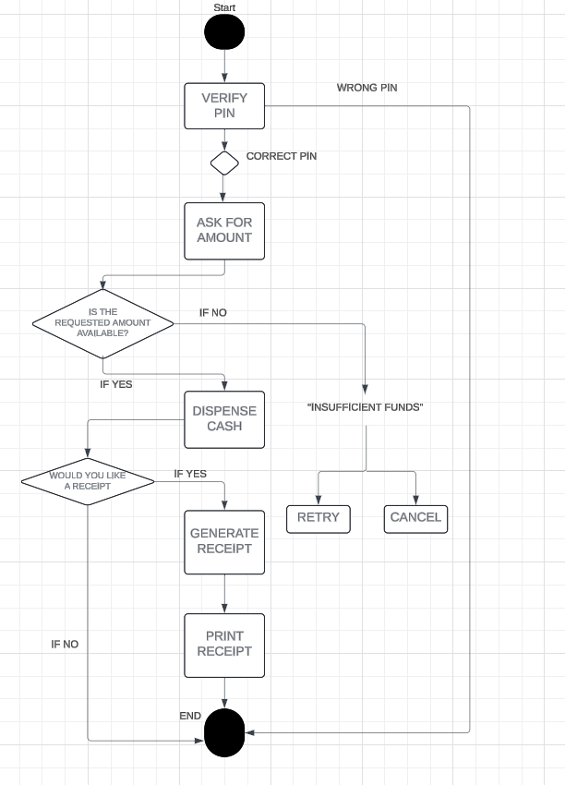
Activity Diagram
Explanation: This diagram breaks down the steps involved in the process of verifying a PIN at an ATM, withdrawing cash, and generating a receipt. The process starts when the user enters their PIN. If the PIN is correct, the user is asked to enter the withdrawal amount. The system checks if the requested amount is available. If sufficient funds are present, cash is dispensed, and the user is asked if they would like a receipt. The process ends after dispensing the cash or printing a receipt. If the PIN is incorrect or funds are insufficient, the user can choose to retry or cancel the transaction.
Notes:
[Explain your diagram. Which use case are you breaking down? What are the steps for this use case? How did you account for DriverPass’s needs in your design? In your explanation, keep your audience in mind. Avoid the use of technical terms such as “nodes,” “control flows,” and so on.]

Slide 5
Security
Data Encryption: All sensitive information, such as user passwords and personal data, is encrypted during transmission to prevent unauthorized access.
Role-Based Access Control: Different levels of access are granted based on the user’s role (e.g., customer, admin, IT officer), ensuring that only authorized personnel can perform sensitive actions like resetting passwords.
Secure Login: The system incorporates secure login methods, requiring strong passwords and multi-factor authentication to prevent unauthorized access to user accounts.
Activity Monitoring: The system tracks and logs user activities to detect and prevent suspicious or malicious behavior.
Regular Security Updates: The system is designed to receive regular security patches and updates to safeguard against vulnerabilities and potential threats.
Notes:
[How did you consider security in your design? In your explanation, keep your audience in mind by avoiding the use of technical terms.]

Slide 6
System Limitations
Internet Dependency: The system requires a stable internet connection for users to access features like scheduling lessons and taking practice tests. Without internet access, users cannot interact with the system.
High Traffic Load: During peak usage times, such as when many users are trying to schedule lessons simultaneously, the system may experience slowdowns or delays.
Mobile Accessibility: Although the system is accessible on mobile devices, certain features may be more optimized for desktop usage, which could affect user experience on smaller screens.
Limited Offline Functionality: The system does not support offline mode, meaning users must be online at all times to complete tasks.
Learning Curve for New Users: Some users may require time to get accustomed to the interface, especially those unfamiliar with online scheduling systems.
Notes:
[What are the limitations of your design? In your explanation, keep your audience in mind by avoiding the use of technical terms.]

